Slide 1
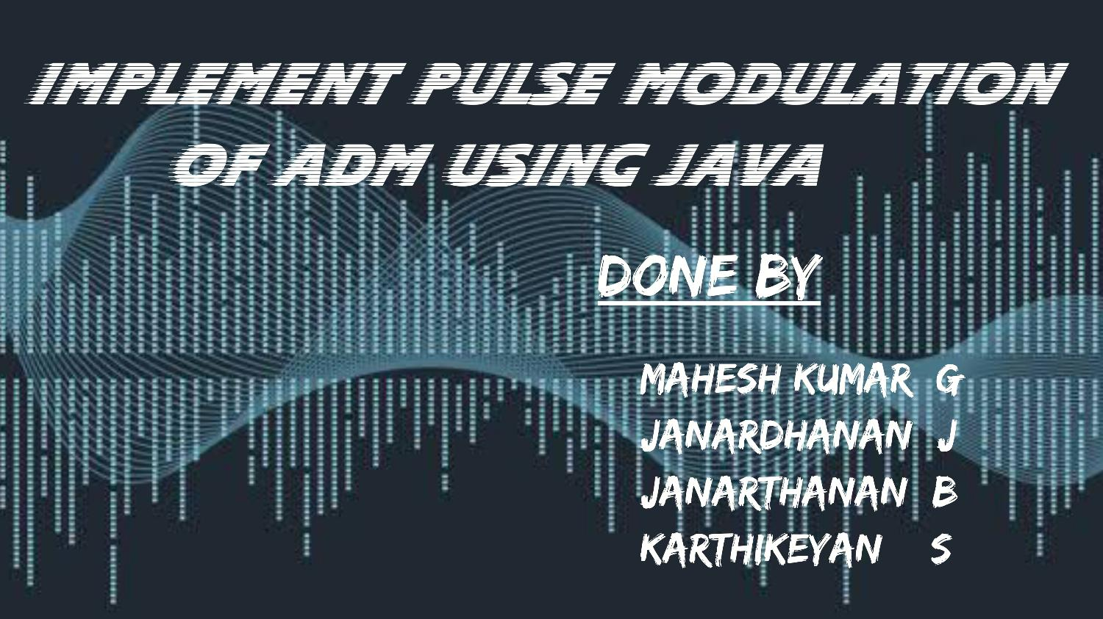

Slide 2
Adaptive Delta modulation (adm)
In digital modulation, we have come across certain problem of determining the step influences the quality of the output wave. A larger step-- size, which size is needed in the steep slope of modulating signal and a smaller step needed where the size is message has a small slope. The minute details get missed in the process. So, it would be better if we can control the adjustment of stepsize, according to our requirement in order to obtain the sampling in a desired fashion. This is the concept of Adaptive Delta Modulation

Slide 3
Introduction
The performance of a delta modulator can be improved significantly by making the step size of the modulator assume a timevarying form. In particular, during a steep segment of the input signal the step size is increased. Conversely, when the input signal is varying slowly, the step size is reduced. In this way, the size is adapted to the level of the input signal. method is c alled adaptive delta modulation (ADM). The resulting There are several types of ADM, depending on the type of scheme used for adjusting the step size. In this ADM, a discrete set of values is provided for t he step size. 39

Slide 4
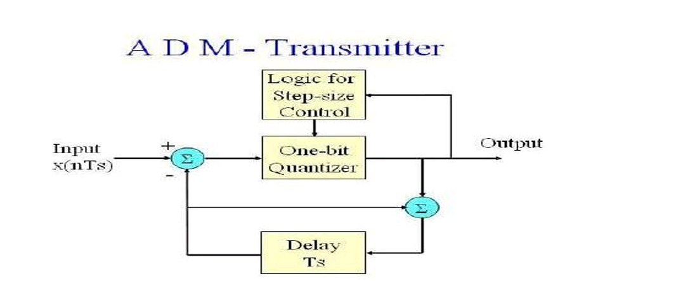
Block diagram of adm Transmitter

Slide 5
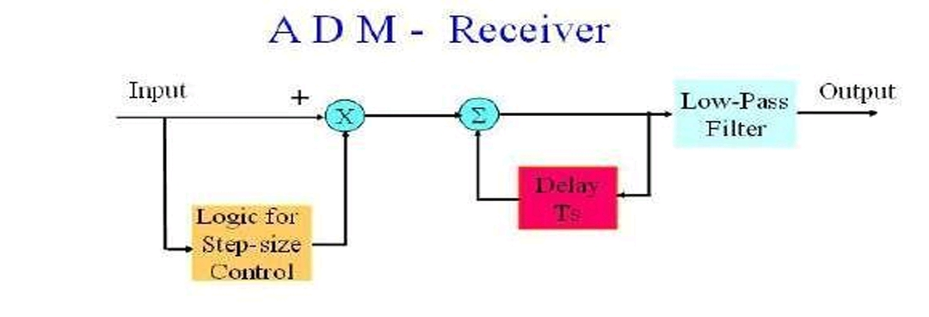
Block diagram of adm receiver

Slide 6
Implementation of adm
The audio signal will pass through a low-pass filter, which can remove all the unwanted signal and only obtain the audio signal. The input signals of the comparator are the audio signal and triangle wave signal, and then the output of the comparator is the square wave signal. The D type flip flop is used as sampling and then the output signal of the flip flop is the modulated ADM signal.

Slide 7
Pulse modulation of ADM
After that the signal will feedback to tunable gain amplifier and level adjuster. In signal x(t) and the reference signal X (t), we can accordance with the different between the input change the magnitude of the gain of the tunable amplifier. If the different of the input signal and the reference signal is very large, then the level adjuster will change the gain of the t unable amplifier so that the value of Δ(t ) will become large.

Slide 8
On the other hand, if the different of the input signal and the reference signal is very small, then the level adjuster will change the gain of the tunable amplifier so that the value of Δ( t ) will become small. With this advantage, when the frequency varia tion of the input signal is large, then we can increase the value of Δ(t) to prevent the occurrence slope overload. And when the frequency variation of the input signal is small, then we can decrease the value of Δ(t) to reduce the error.
Reference link : https://www.tutorialspoint.com/digital_communication/digital_communication_pulse_code_modulation.htm

Slide 9
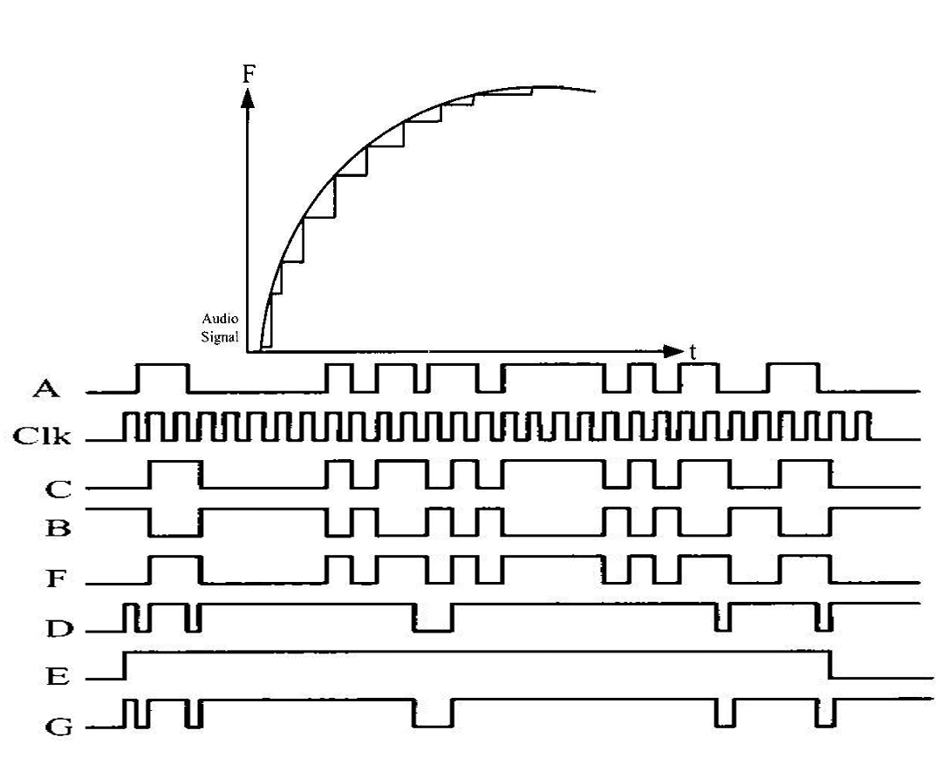
Waveforms of adm

Slide 10
Advantages of ADM
This modulation can be used to reduce the slope error which is present in delta modulation.
This can be used to remove the granular noises from the signal.
It has an improved signal to noise ratio as compared to that of delta modulation.
ADM has a low pass filter that can be used to remove the quantization noise.
It has a higher dynamic range as compared to delta modulation.
There is no need for error detection in the case of adaptive delta modulation

Slide 11
Applications Of adm
It is effectively used in audio communications.
It can be used in systems that require improved voice quality.
It is used in voice coding.
It is used in television signal transmission.
The SECURENET line of Motorola uses 12kbit/sec adaptive delta modulation.
It is used by NASA for different communications between spacecraft and mission control.
The US Army also uses adaptive delta modulation in order to conserve bandwidth over various tactical links.

Slide 12


